Slide 1
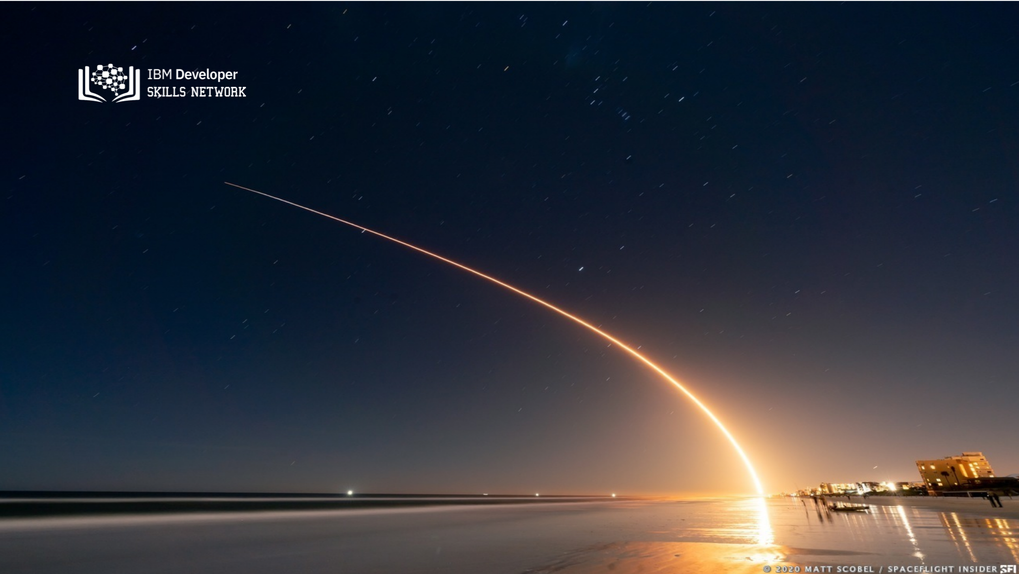
SpaceX Falcon 9 First Stage landing prediction
Fan Zhao Ting
2022.03.23

Slide 2

Outline
Executive Summary
Introduction
Methodology
Results
Conclusion
Appendix

Slide 3
Executive Summary
In an intensely competitive business landscape, SpaceX has emerged as a pioneer in the aerospace industry through its groundbreaking approach of reusing the initial stage launcher/booster of the Falcon 9 rocket, resulting in substantial cost savings amounting to millions of dollars.
To maintain its competitive edge in cost-efficiency compared to traditional launchers, the success of Falcon 9 missions hinges on specific factors, including:
Orbit
Payload mass
Booster version
launch sites
The research conducted for this report led to the development of a supervised machine learning classification model. This model, with an accuracy rate nearing 94%, successfully predicts the outcome of booster recovery based on these critical mission features.

Slide 4
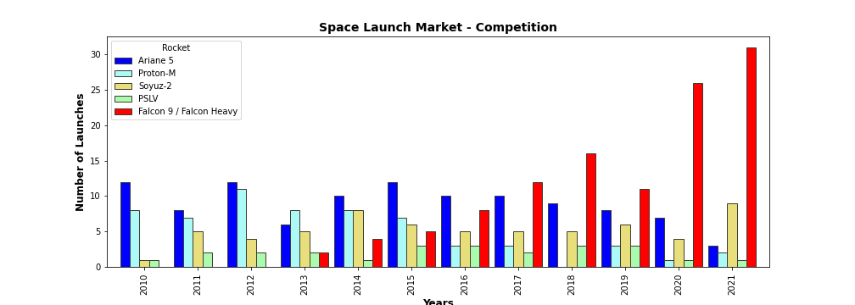
Introduction
SpaceX advertises Falcon 9 rocket launches on its website, with a cost of 62 million dollars; other providers cost upward of 165 million dollars each, much of the savings is because SpaceX can reuse the first stage. Therefore if we can determine if the first stage will land, we can determine the cost of a launch. This information can be used if an alternate company wants to bid against SpaceX for a rocket launch.
Problems you want to find answers
What factors determine if the rocket will land successfully?
The interaction amongst various features that determine the success rate of a successful landing.
What operating conditions needs to be in place to ensure a successful landing program.

Slide 5

Section 1

Slide 6
Methodology
Data collection from open Data (SpaceX API and web scraping from Wikipedia)
Data wrangling(One-hot encoding was applied to categorical features)
Exploratory data analysis (EDA) using visualization and SQL
Perform interactive visual analytics using Folium and Tableau
Classification Models development and validations. Selection of best predictive model.

Slide 7
Data Collection
SpaceX REST API
Web scraping Wikipedia
Requested and parsed SpaceX launch data
Get URL response
Data was collected from:
-open source SpaceX REST API
-webscraping Falcon9 launch data in Wikipedia
Restricted dataframe to Falcon 9 launches
Extract Table data with Beautiful soup
Replaced missing payload value with mean value
Clean
Saved data into csv file
data_set_part1.csv
Saved data into csv file
data_set_part2.csv

Slide 8
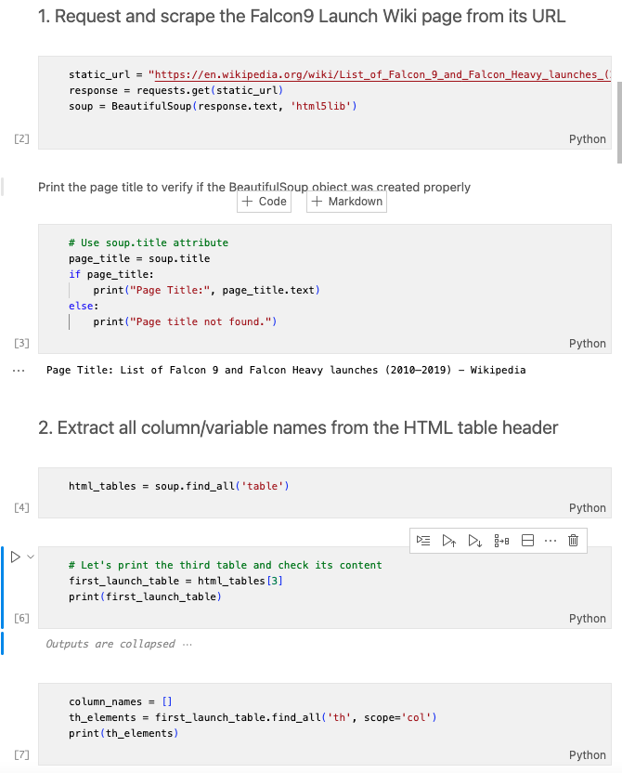
Data Collection - Web Scraping
Acquired historical launch data from Wikipedia page 'List of Falcon 9 and Falcon Heavy Launches' with BeautifulSoup
We parsed the table and converted it into a pandas dataframe.
The link to the notebook is https://github.com/brianfn/private-space-launch
-company-analysis/blob/
main/falcon_webscraping.ipynb

Slide 9
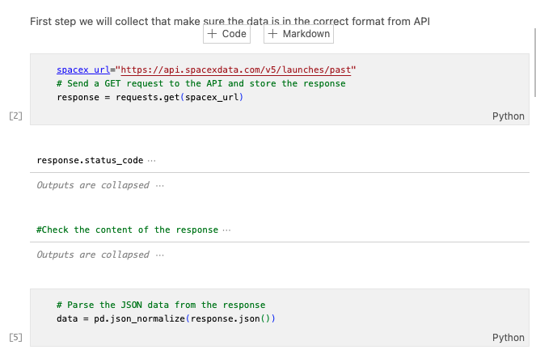
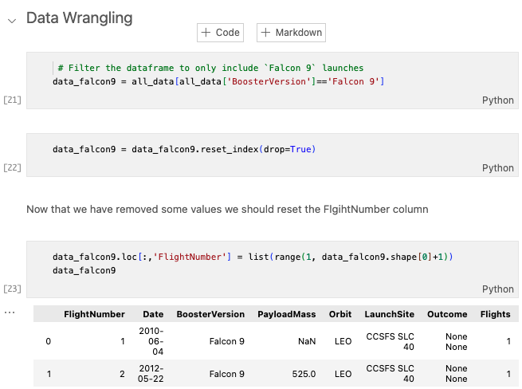
Data Collection – SpaceX API
Requested rocket launch data from SpaceX API
url=https://api.spacexdata.com/v4/launches/past
Requested and parsed
SpaceX data with GET request
data wrangling and formatting
The link to the notebook is https://github.com/brianfn/private-space-launch-company-analysis/blob/main/falcon_api.ipynb

Slide 10

Data Wrangling
We performed exploratory data analysis and determined the training labels.
We calculated the number of launches at each site, and the number and occurrence of each orbits
We created landing outcome label from outcome column and exported the results to csv.
The link to the notebook is https://github.com/brianfn/private-space-launch-company-analysis/blob/main/falcon_datawrangling.ipynb

Slide 11

EDA with Data Visualization
We explored the data by visualizing the relationship between
flight number and payload
payload and launch site
success rate of each orbit type
flight number and orbit type
launch success yearly trend.
The link to the notebook is https://github.com/brianfn/private-space-launch-company-analysis/blob/main/falcon_eda_dataviz.ipynb

Slide 12
EDA with SQL
establishing a connection to an SQLite database and load dataset inside
We applied EDA with SQL to get insight from the data. We wrote queries to find out for instance:
The names of unique launch sites in the space mission.
The total payload mass carried by boosters launched by NASA (CRS)
The average payload mass carried by booster version F9 v1.1
The total number of successful and failure mission outcomes
The failed landing outcomes in drone ship, their booster version and launch site names.
The link to the notebook is https://github.com/chuksoo/IBM-Data-Science-Capstone-SpaceX/blob/main/EDA%20with%20SQL.ipynb

Slide 13
Build an Interactive Map with Folium
Folium Interactive Map was used for visualizing and analyzing SpaceX Launch Sites
Utilize objects in Folium library like markers, circles to:
Identified all SpaceX launch sites on a map: Florida, California.
Included longitude and latitude info.
Identified successful/failed launches for each site on map.
We calculated the distances between a launch site to its proximities. We answered some question for instance:
Are launch sites near railways, highways and coastlines.
Do launch sites keep certain distance away from cities.

Slide 14
Build a Dashboard with Tableau
Interactive dashboard with Plotly including:
Show the total launches by a certain sites
the landing success rate troughout the year
Range slider for selecting range of payload mass (kg).
Analyzing SpaceX launch records features:
site with largest successful launches.
site with highest launch success rate
F9 Booster version (v1.0, v1.1, FT, B4, B5, etc.) with highest launch success rate.
The link to the notebook is https://github.com/chuksoo/IBM-Data-Science-Capstone-SpaceX/blob/main/app.py

Slide 15
Predictive Analysis (Classification)
Load the data using numpy and pandas, transformed the data, split our data into training and testing.
Built Logistic Regression, SVM, DT, KNN models and tune different hyperparameters using GridSearchCV.
We used accuracy and Confusion matrix as the metric for our model, improved the model using feature engineering and algorithm tuning.
Select bet model
The link to the notebook is https://github.com/brianfn/private-space-launch-company-analysis/blob/main/falcon_ML_Predict.ipynb

Slide 16
Results
Exploratory data analysis results
Interactive analytics demo in screenshots
Predictive analysis results

Slide 17

Section 2

Slide 18
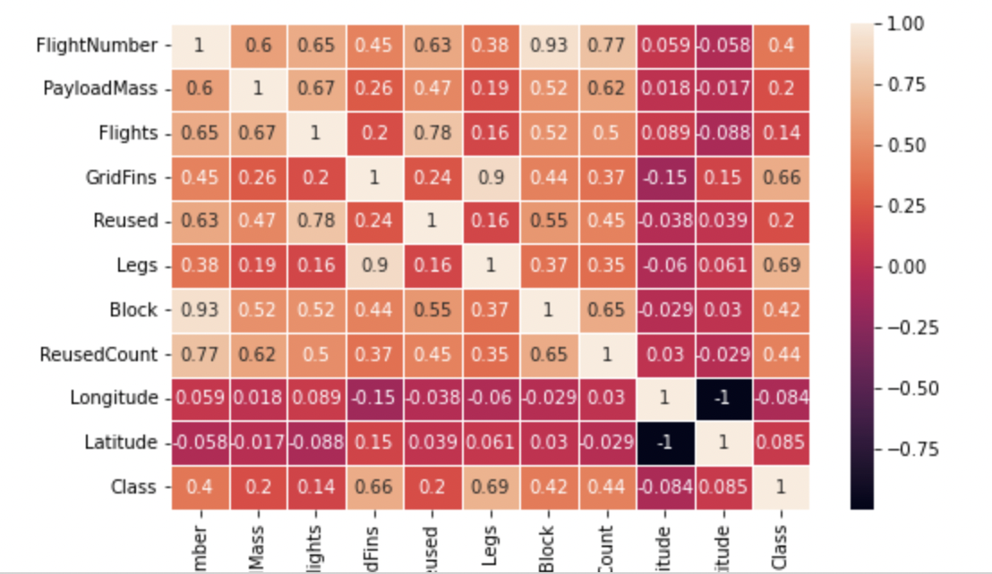
Feature Correlation
From the heatmap, we can see the usage of Legs and GridFins has influential effects on the outcome, The larger the block, the larger the class is

Slide 19

Flight Number vs. Launch Site
Launch sites have different success rates. KSC LC-39A and VAFB SLC 4E seems to have higher success rate than CCAFS LC-40.

Slide 20
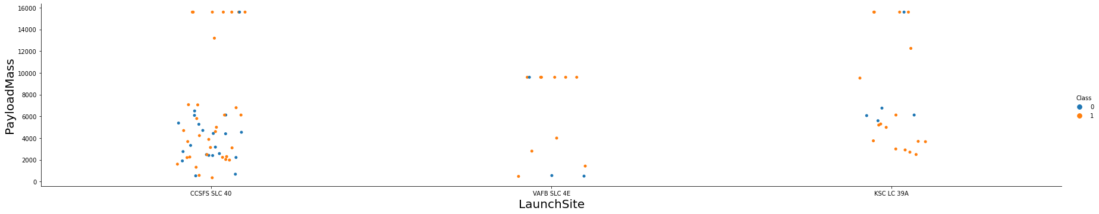
Payload vs. Launch Site
VAFB-SLC launchsite there are no rockets launched for heavypayload mass(greater than 10000).

Slide 21

Success Rate vs. Orbit Type
From the plot, we can see that ES-L1, GEO, HEO, SSO, VLEO had the most success rate.

Slide 22
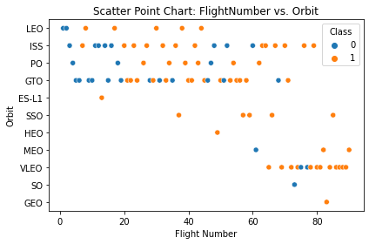
Flight Number vs. Orbit Type
We observe that in the LEO orbit, success is related to the number of flights whereas in the GTO orbit, there is no relationship between flight number and the orbit.

Slide 23
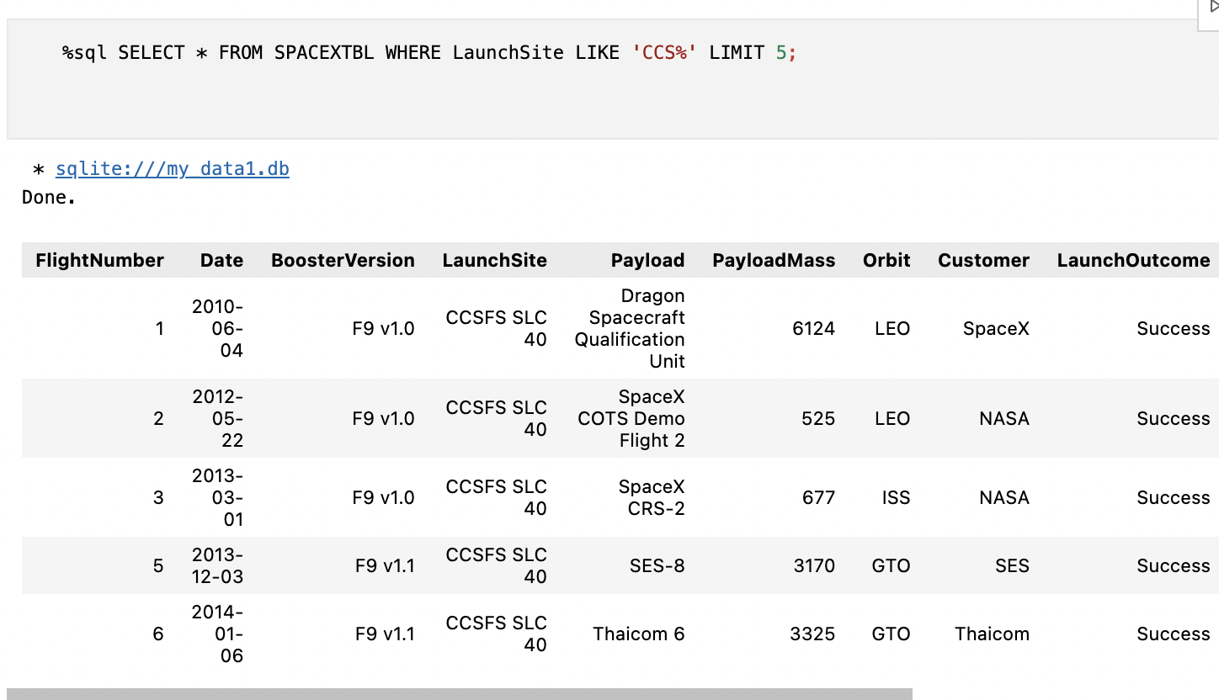
Launch Site Names Begin with 'CCA'
We used the query above to display 5 records where launch sites begin with `CCA`

Slide 24
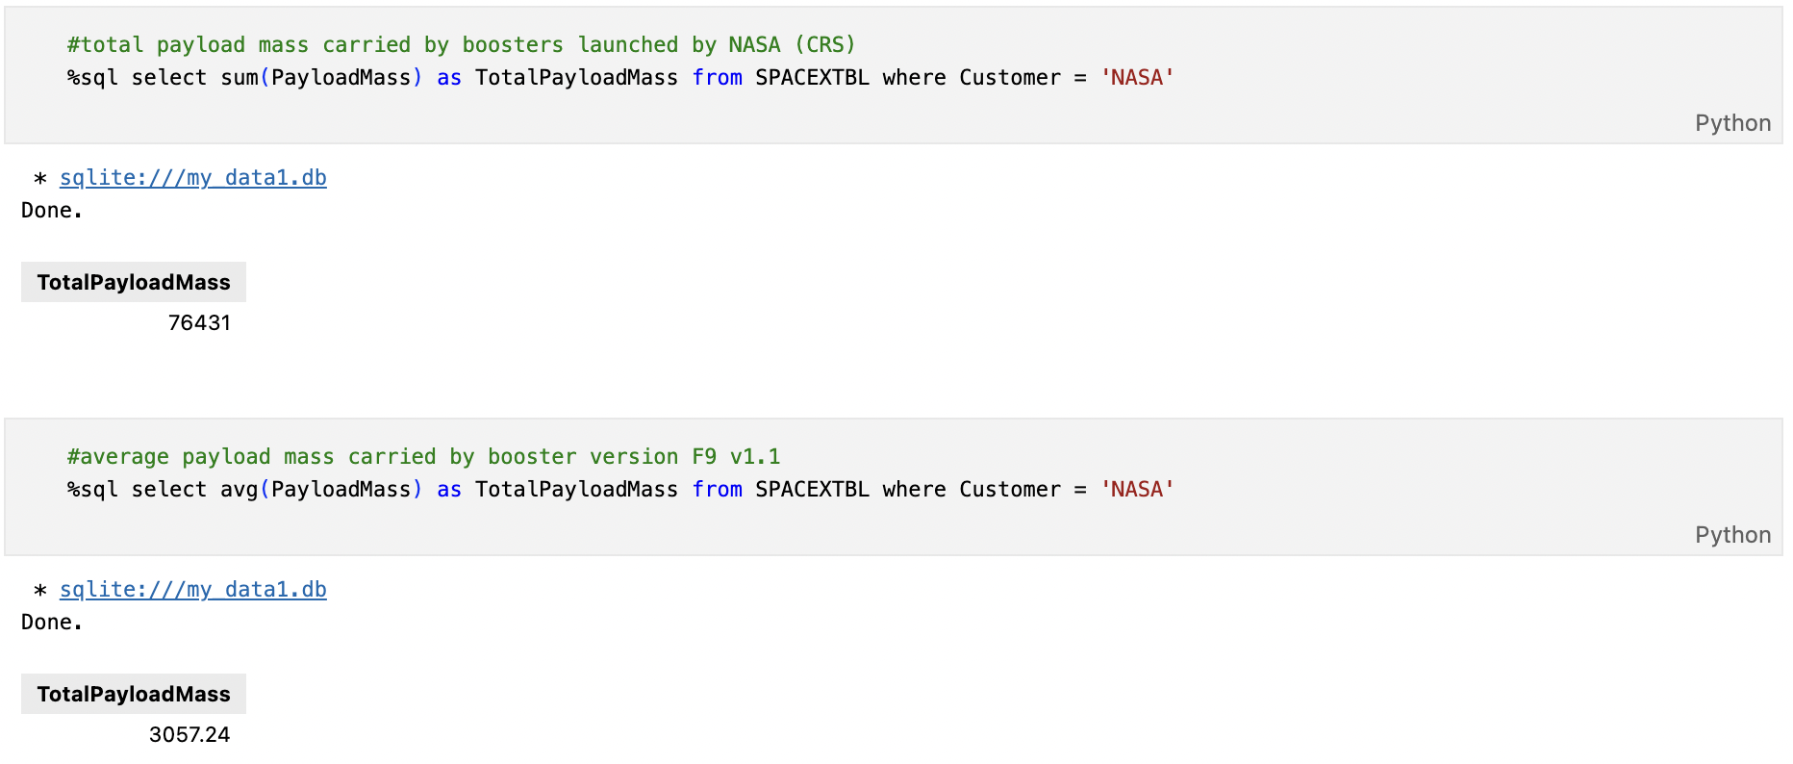
Total and Average Payload Mass by NASA
We calculated the total payload carried by boosters from NASA as 76431 using the query below
3057.24 in average

Slide 25
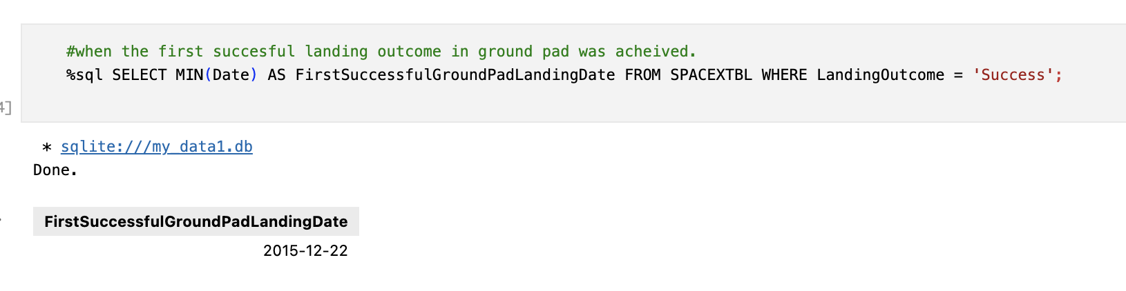
First Successful Ground Landing Date
We observed that the dates of the first successful landing outcome on ground pad was 22nd December 2015

Slide 26
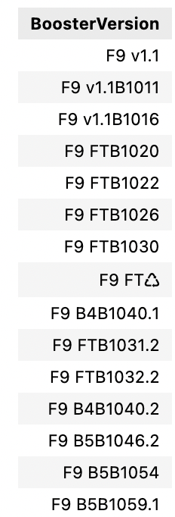
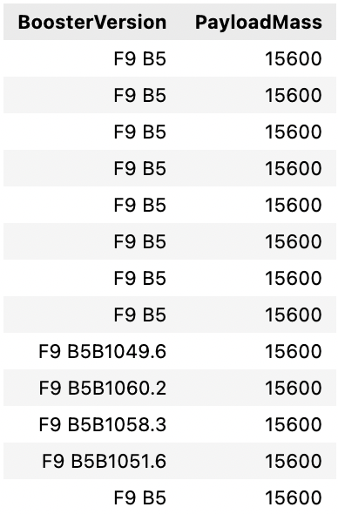
Query Booster Version with different payload mass
the booster_versions which have carried the maximum payload mass. Use a subquery
Extract the Booster Version with
successful landing, payload mass
greater than 4000 but less than 6000

Slide 27
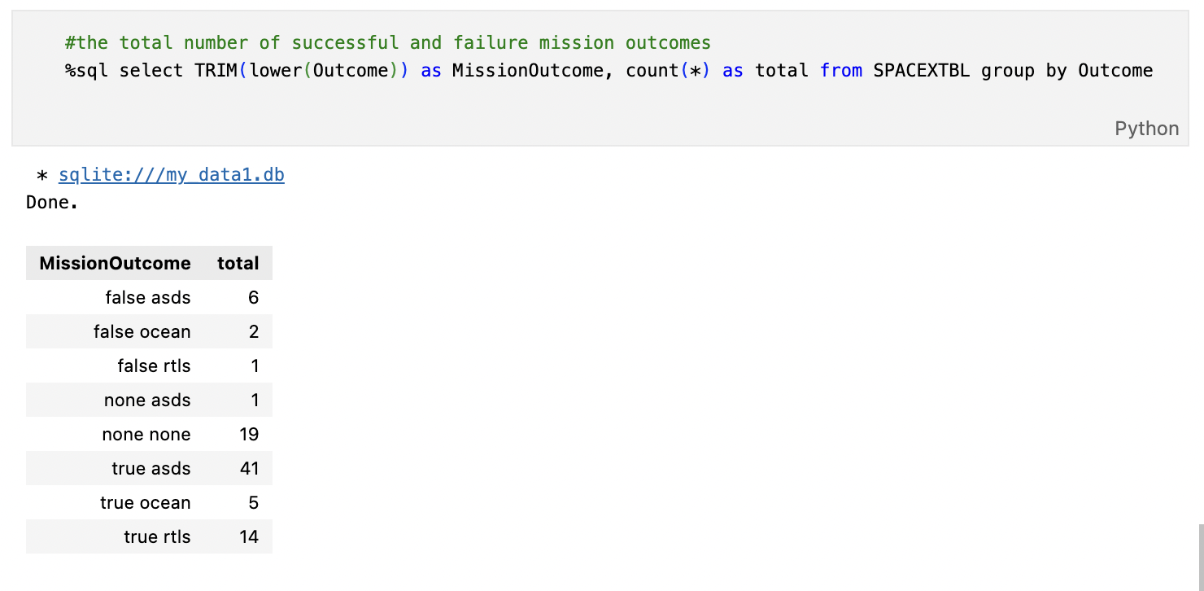
Total Number of Successful and Failure Mission Outcomes
From here we can see landing in Ocean(7 trails in total) have 2 timesof failure landing, with is 28.6%. On the other hand, landing on the ground pad relatively safer with 93.3% of success landing out of 15 trails.

Slide 28
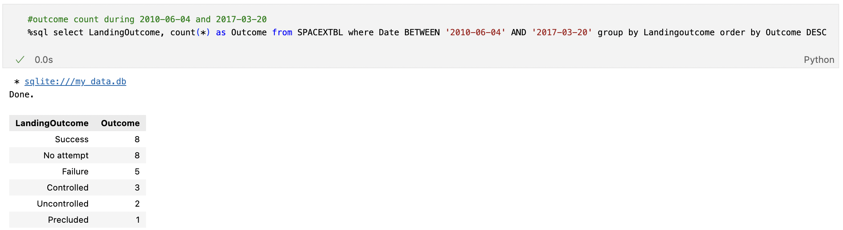
Rank Landing Outcomes Between 2010-06-04 and 2017-03-20
select Landing outcomes and the COUNT of landing outcomes from the data and used the WHERE clause to filter for landing outcomes BETWEEN 2010-06-04 to 2017-03-20.
We applied the GROUP BY clause to group the landing outcomes and the ORDER BY clause to order the grouped landing outcome in descending order.

Slide 29

Section 3

Slide 30
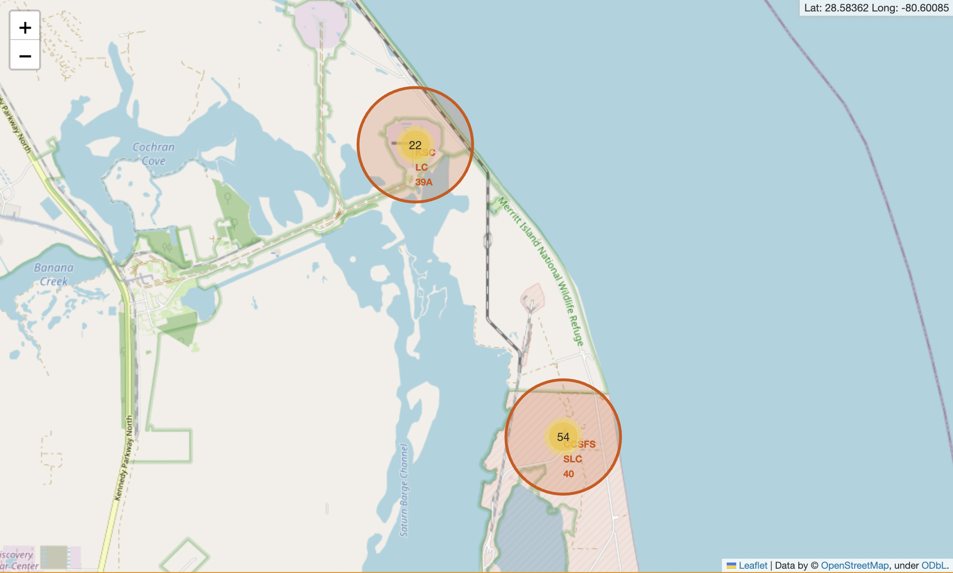
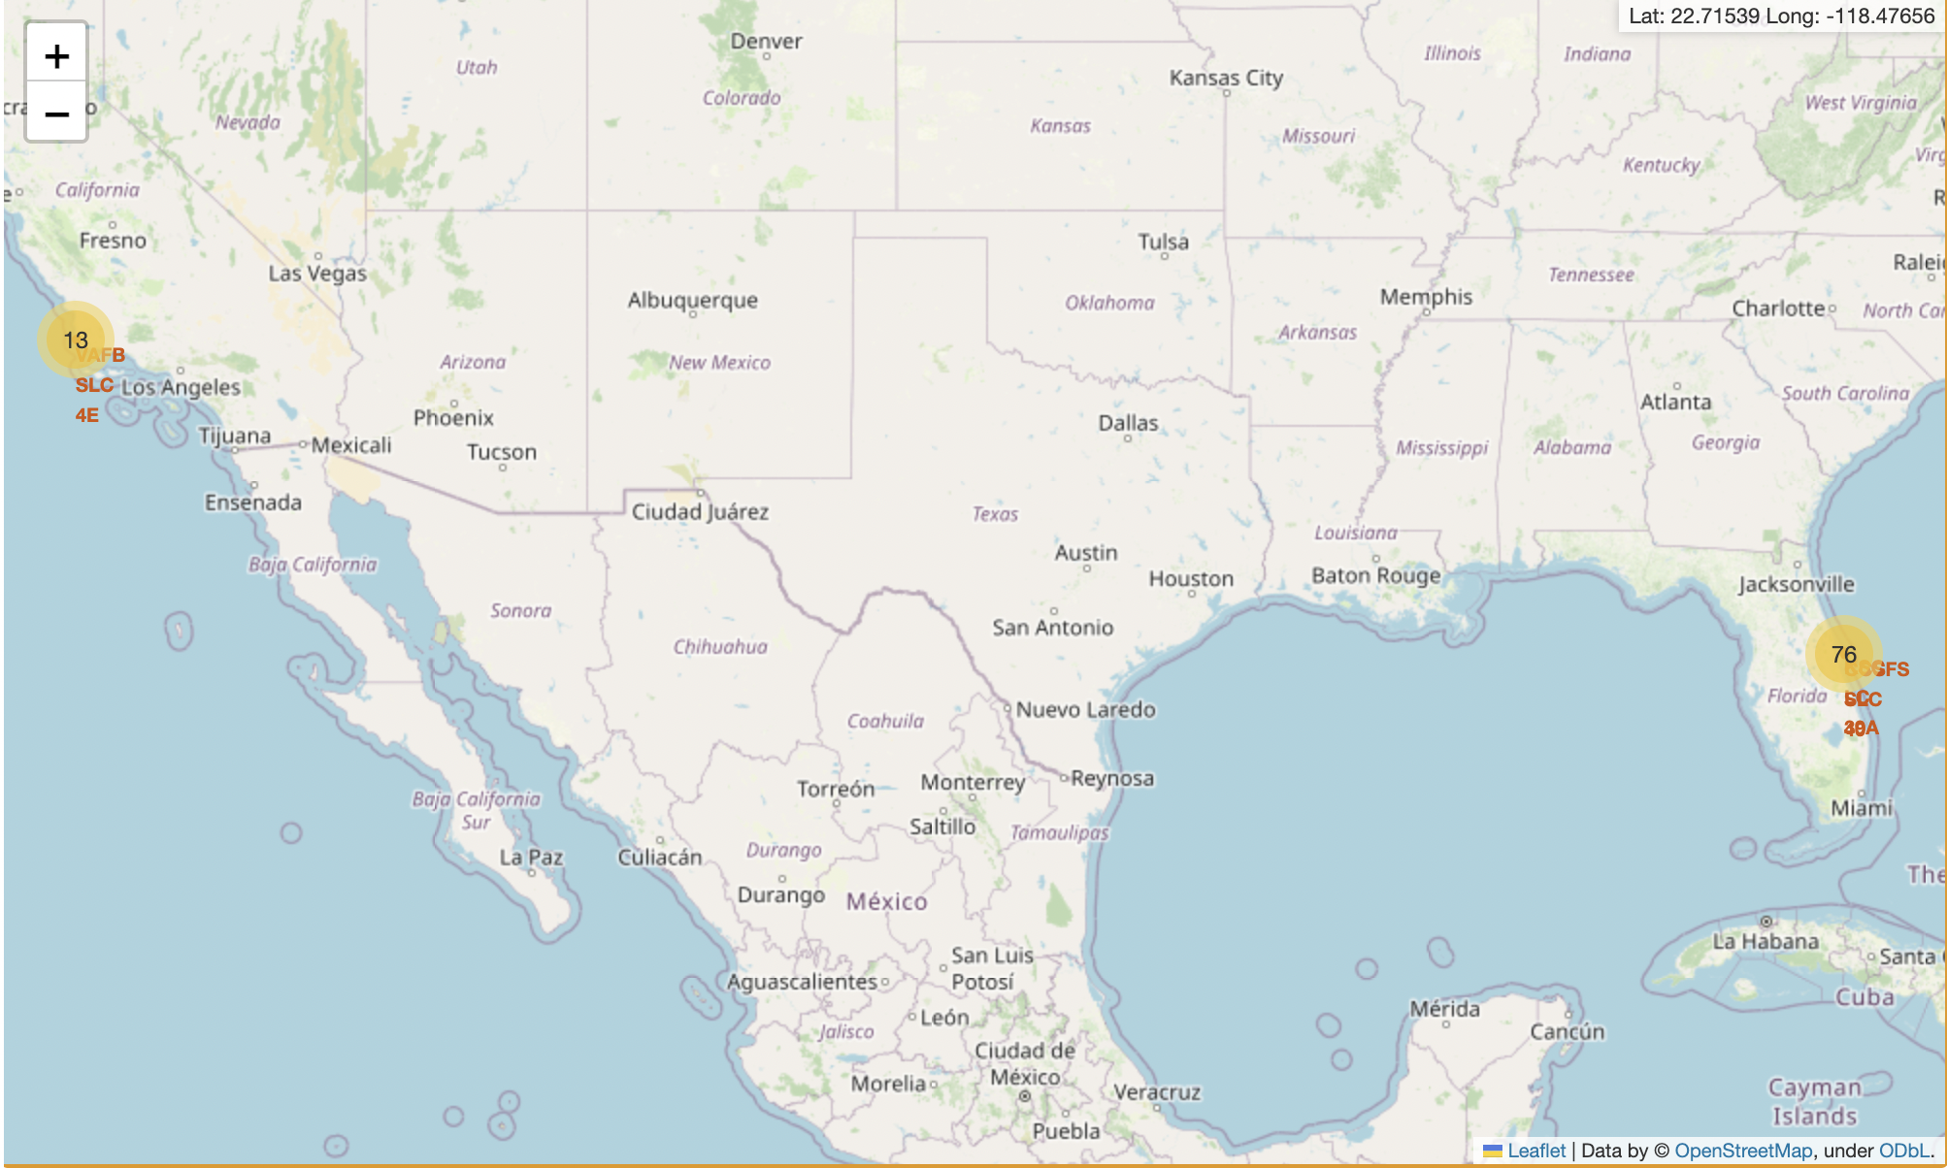
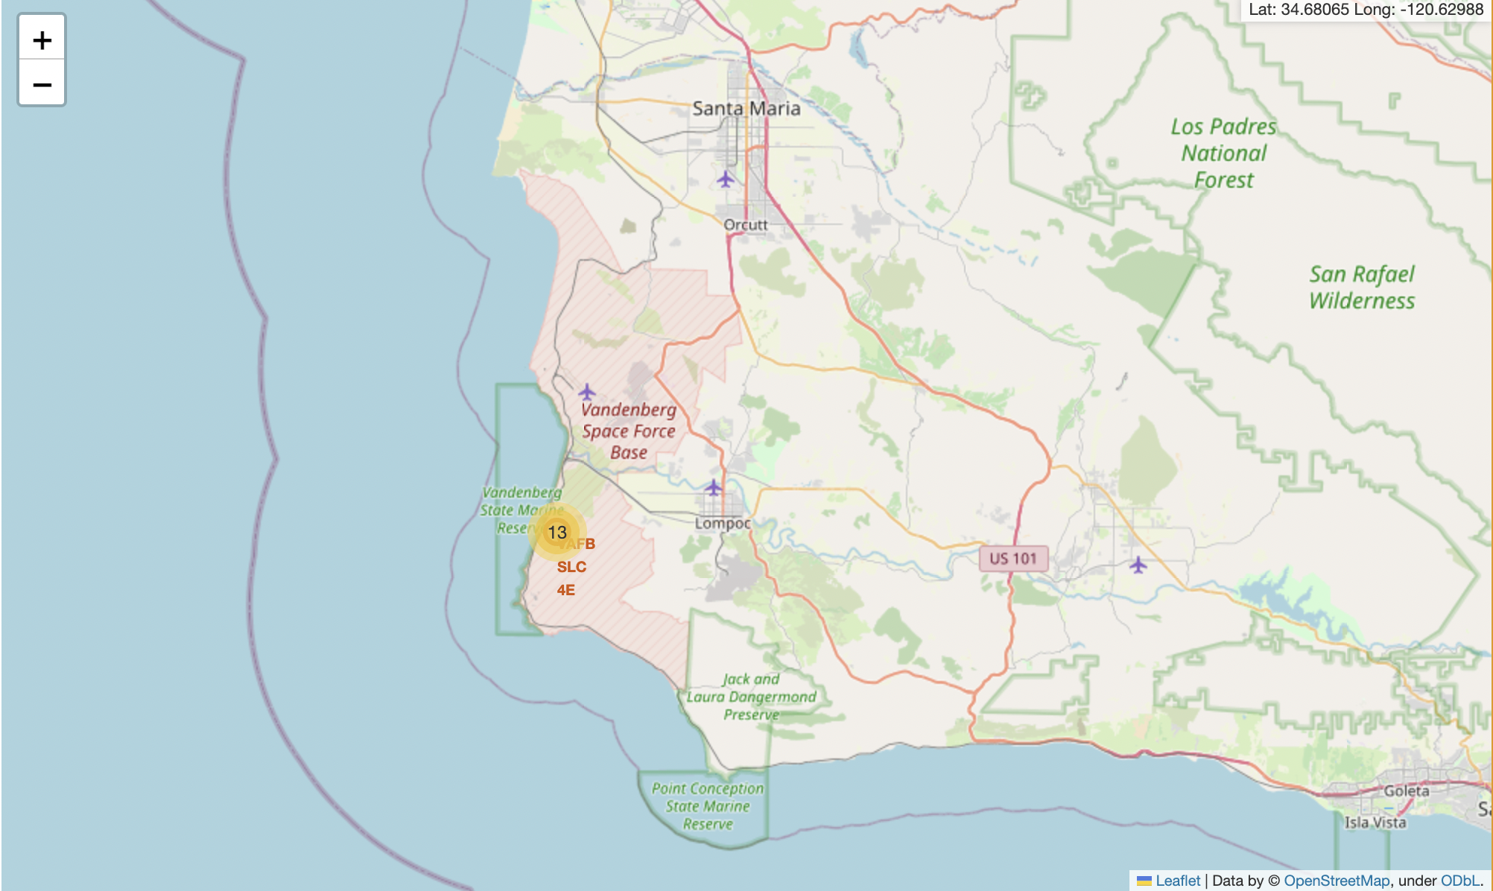
SpaceX: All launch sites
KSC-LC29A: Kennedy Space Center - Merritt Island (FL)
VAFB SLC-4E: Vandenberg Space Launch Complex 4 (CA)
CCAF-SLC40: Cape Canaveral Space Launch Complex 40(FL)
We can see that the space lunch sites are in the US in California and Florida
The link to the notebook is https://github.com/brianfn/private-space-launch-companyanalysis/blob/main/lab_jupyter_launch_site_location.ipynb

Slide 31
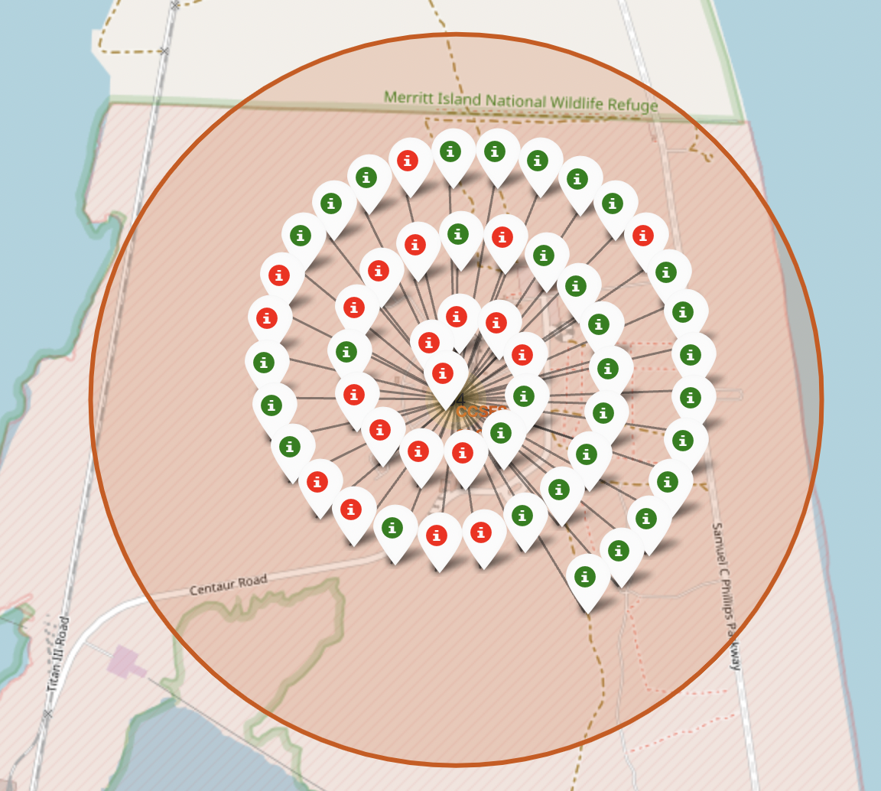
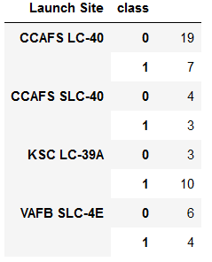
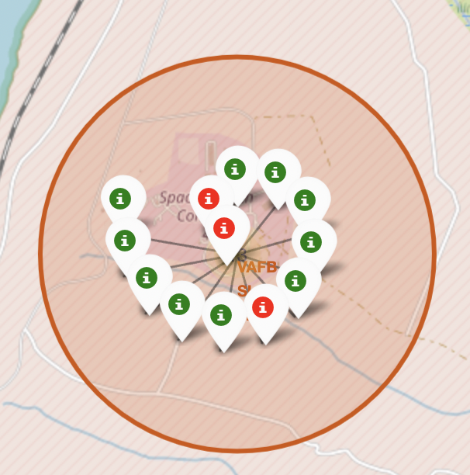
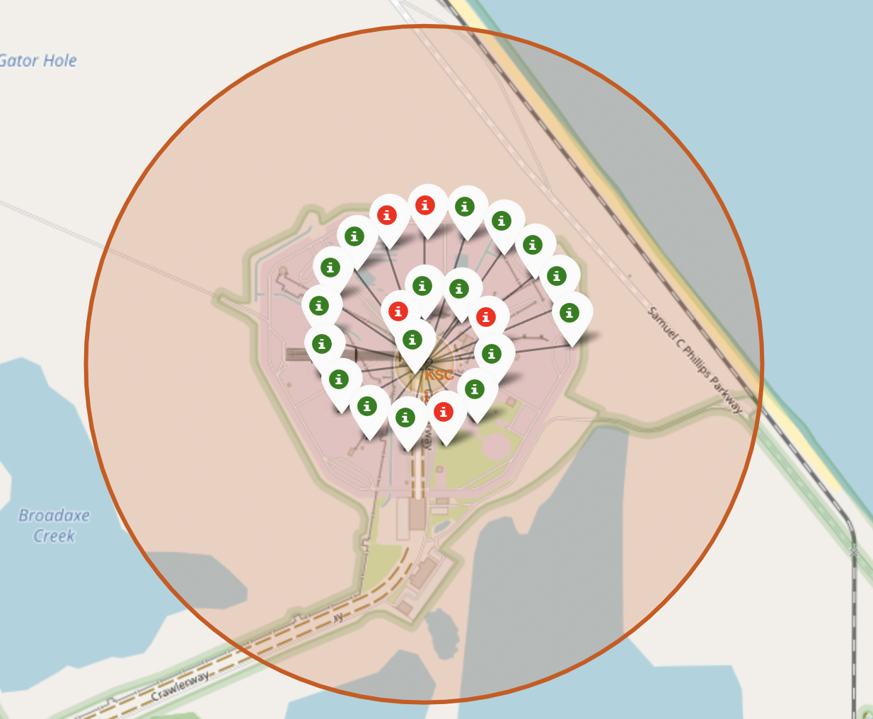
Falcon 9 Success/Failed launches for each site
Florida
California
Kennedy Space Center -
Merritt Island (FL)--KSC-LC29A
Vandenberg Space Launch Complex 4 (CA)--VAFB SLC-4E
Green marker shows successful Lunches and red marker show Failures
Cape Canaveral (FL)
CCSFS SLC 40

Slide 32
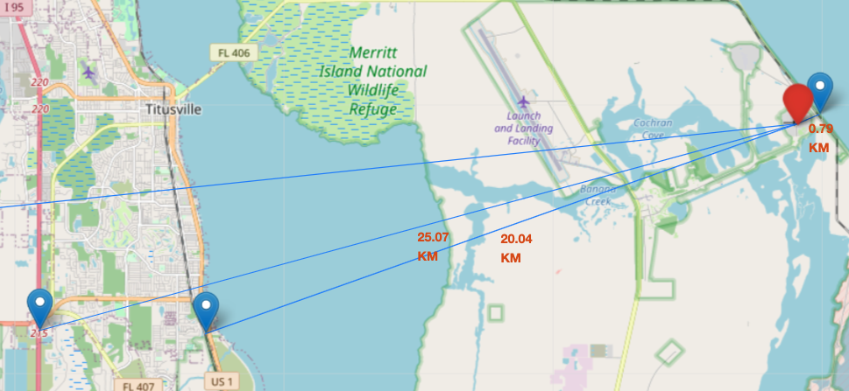
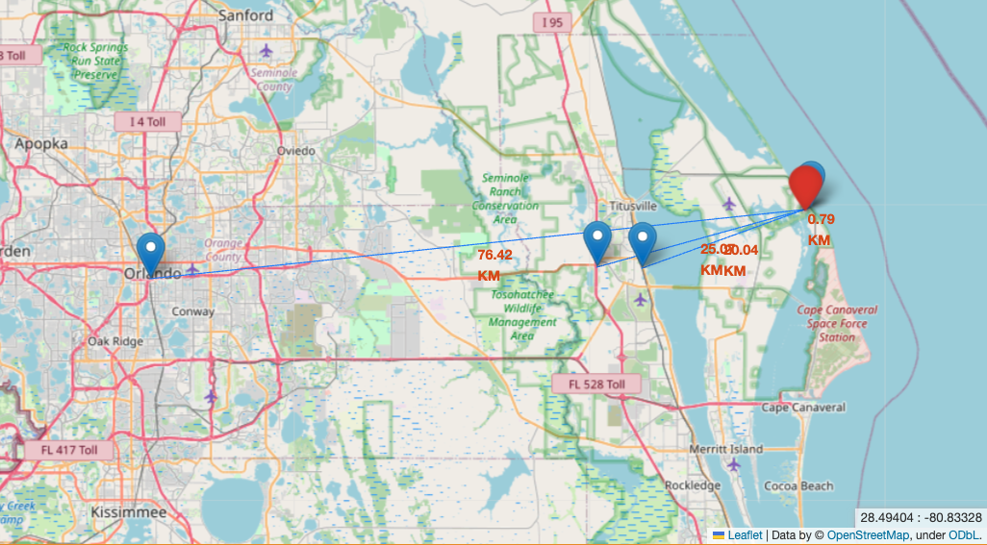
Distances between a launch site to its proximities
Distance from CCAFS_SLC40 to:
Closest coast: ~800 m
Florida East Coast Railway: 20.04 km
Highway I 95: 25.07 km
Orlando: 76.42 km
Launch sites are close to coasts. For safety issues if launcher is lost in the early stage of the flight.
Rockets are launched:
From West to East over the ocean in Florida.
North or South bound over the ocean in California. (Polar orbits only)
Launch sites are relatively far from populated areas for protecting population from serious incidents at lift off: explosion on the launch pad.

Slide 33

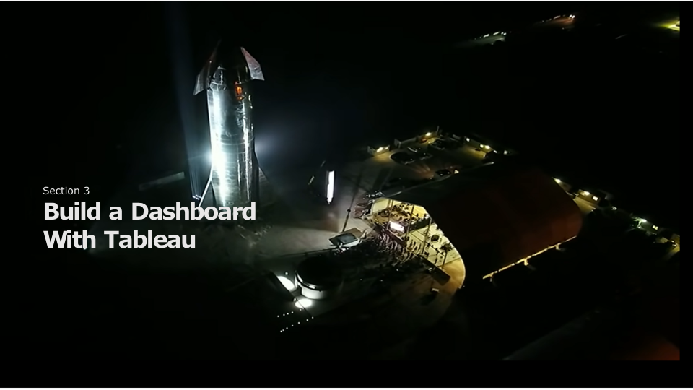
Section 4

Slide 34

Section 5

Slide 35
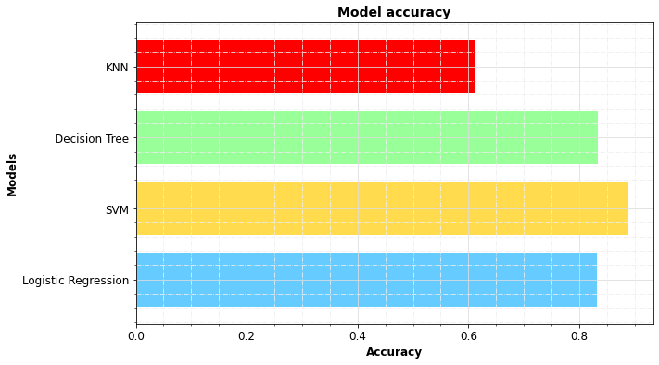
Classification Accuracy
Classification Accuracy with test set.
Results with “train test split” random_state=3
Optimization of SVM and LR hyper-parameters was refined for increasing accuracy with train set.
It did not necessarily improved accuracy with test set.
Test set is too small.
In our case, SVM exhibits the best accuracy: ~89%

Slide 36
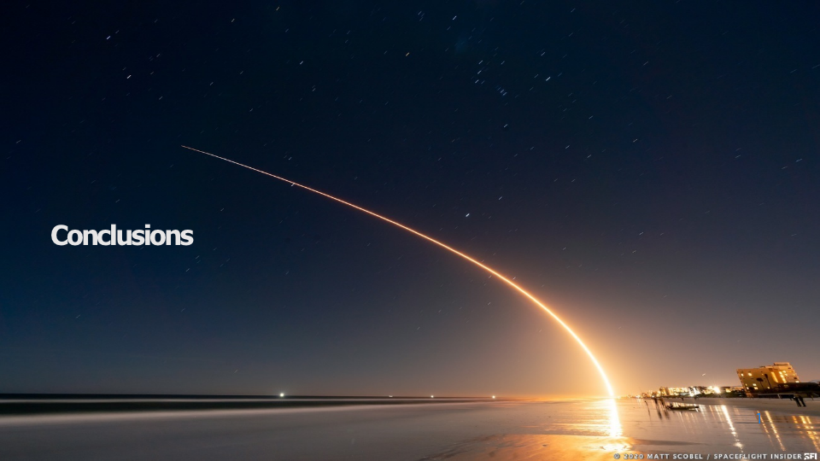
Conclusions

Slide 37
Conclusions
We defined success as a successful recovery process of Falcon9 booster.
From Falcon 9 and Wiki we imported data and developed tools for investigating factors driving successful booster recovery:
Payload, Orbit, Booster version, Launching sites…
The larger the flight amount at a launch site, the greater the success rate at a launch site.
Based on these features, we selected a supervised classification model capable of predicting launch outcome with a 89% accuracy.
SpaceX GEO/GTO flights are more risky.
Launch success rate started to increase in 2013 till 2020.
KSC LC-39A had the most successful launches of any sites.

Slide 38


